Slide 1
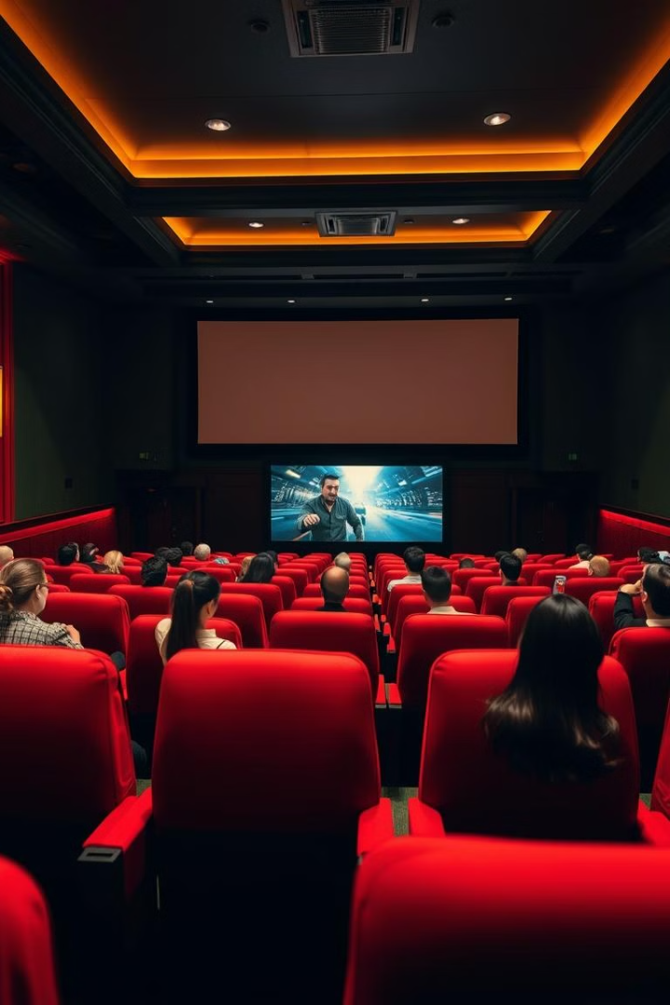
Building a Movie Recommendation System with Machine Learning and Python
With the rise of online streaming platforms, users are often overwhelmed by the vast selection of movies available. Choosing the right movie based on personal preferences can be challenging.
This project aims to develop a machine learning-based movie recommendation system that suggests movies to users based on their past interactions, preferences, or similar user behaviors thus improving user experience and engagement.

Slide 2
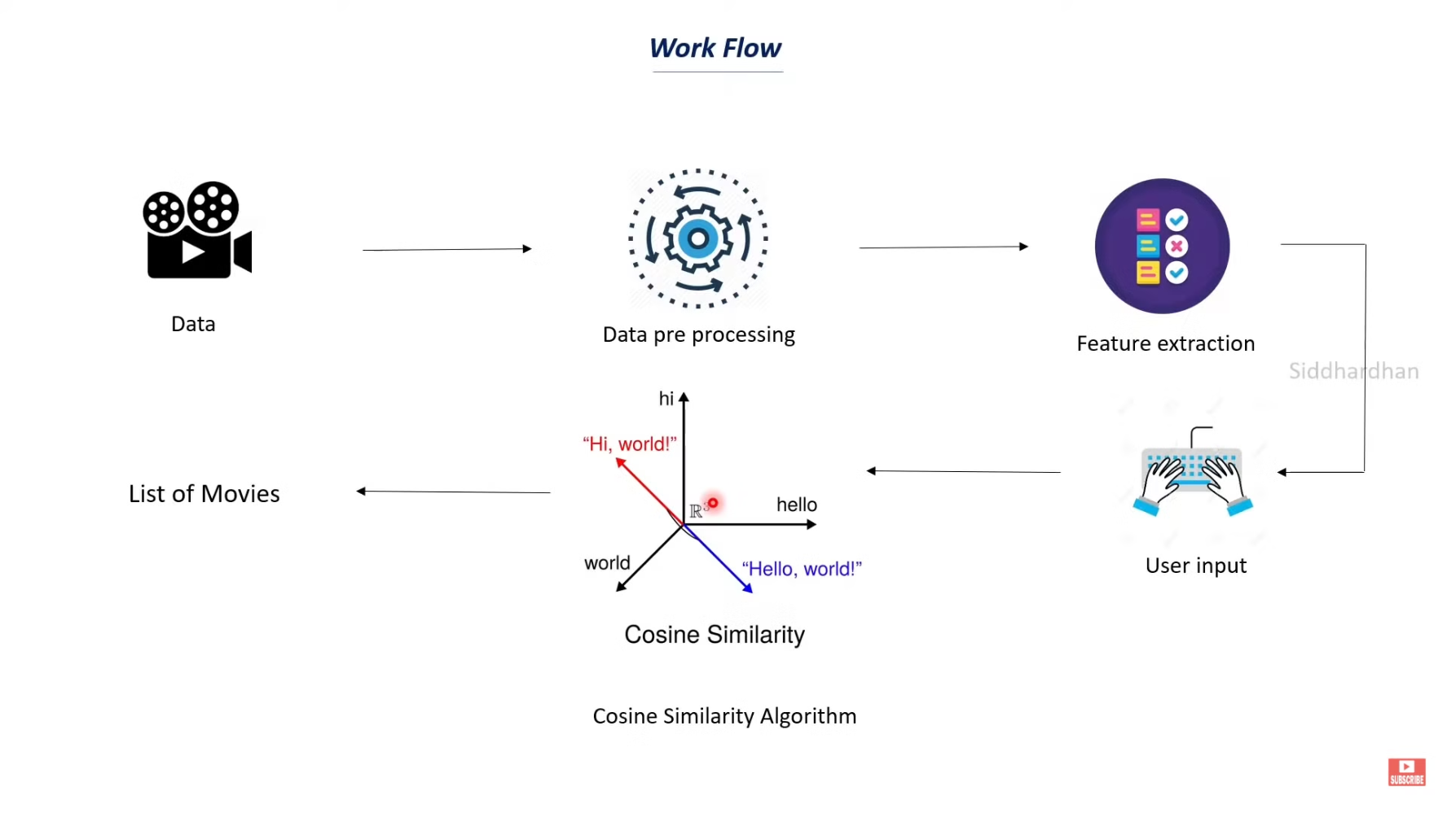
Machine Learning Model: Collaborative Filtering
Collaborative filtering uses a user-item interaction matrix. Memory-based methods use user-based and item-based approaches. Similarity metrics include Cosine and Pearson correlation. Model-based methods use matrix factorization and embeddings.

Slide 3





Implementation in Python
Use Pandas, NumPy, Scikit-learn, and Surprise libraries. Preprocess data by loading, cleaning, and splitting. An 80/20 split is used for training and testing. Implement collaborative filtering algorithms.
Data Prep
Load and clean
Model Build
Implement CF
Train
Fit and measure
Recommend
Suggest movies

Slide 4
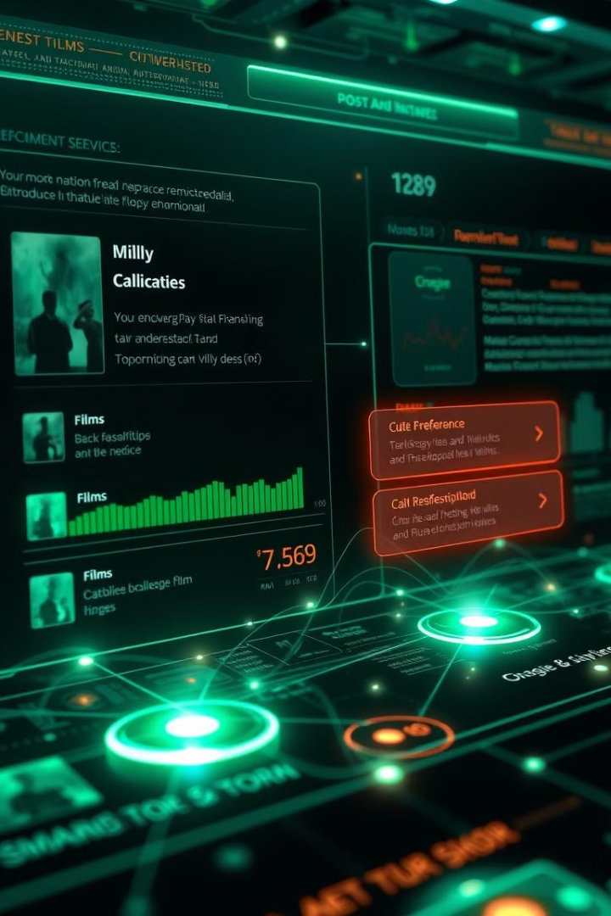
Types of Recommendation Systems
Recommendation systems enhance user experience. Collaborative filtering is powerful. Python simplifies implementation. Further exploration should be content-based filtering.
Content-Based filtering
Suggests movies based on features (genre, actors, etc.)
Hybrid Systems
Combination of both for better accuracy
Collaborative Filtering
Suggests movies based on similar users' preferences

Slide 5
Data Set - Data Set
COLAB CODE -COLAB CODE

